Slide 1

FINAL PROJECT REPORT DEVELOP DEVICE DRIVER FOR CAMERA IN LINUX
Mentor: Nguyen Xuan Thong
Reporter: Huynh Trong Phuoc

Slide 2

Agenda
Requirement of the project
Key deliverable
Result
Demo
Lesson learn

Slide 3

1) Requirement of project
Develop usb camera driver for mangOH Green board.
Develop application in userspace to capture image form camera.

Slide 4
1) Requirement of project
Kernel Space
The driver will interact with camera device, allocate memory and create the device file.
b) User space
Build a application use APIs that provided by driver.
Application will get the image in kernel space and stored it in user space memory.

Slide 5
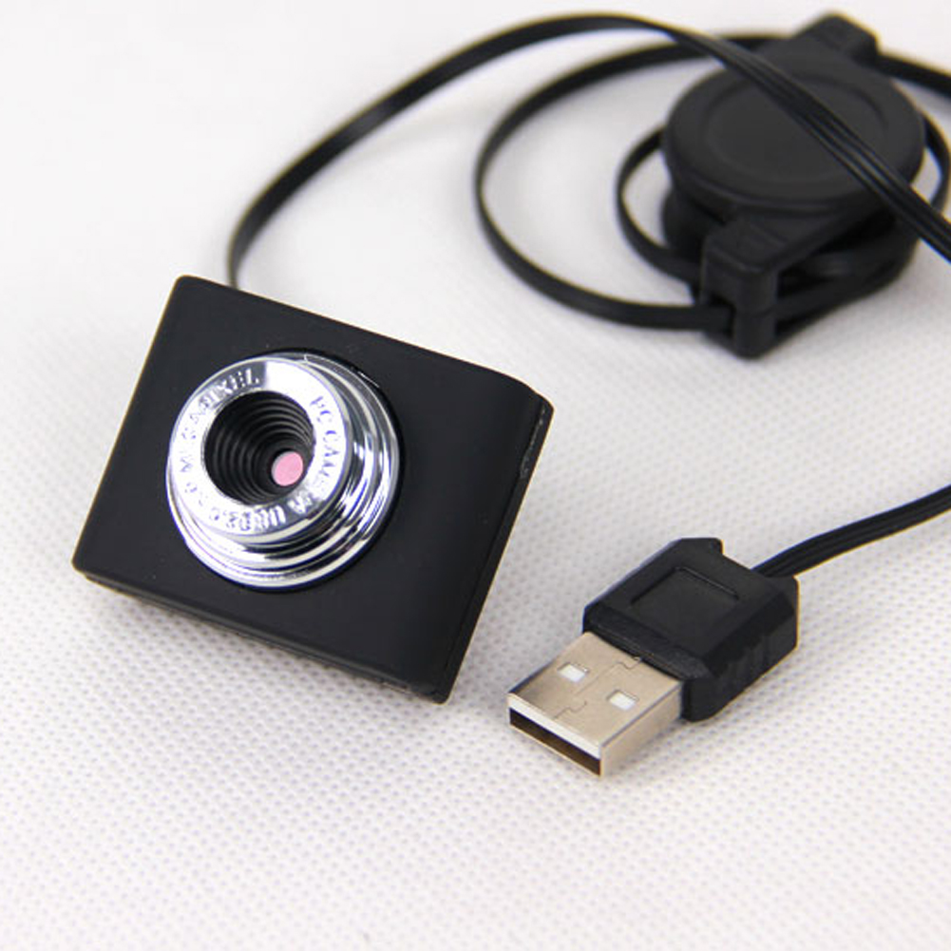
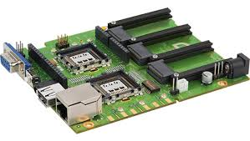
Component of the project
MangOH Green Dev Board
USB 2.0 Camera

Slide 6

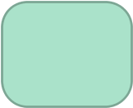


Camera interface diagram
User Application
M
e
m
o
r
y
ARM
core
COPY!
Frame buffer
DATA
Camera
Module
DATA
/dev/video
OK
Cancel

Slide 7
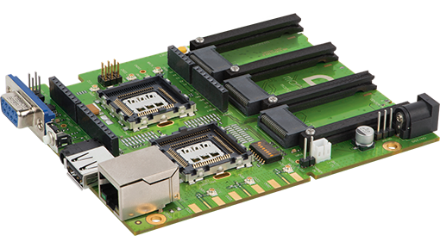
2) Key deliverable
mangOH Green development board and Legato Platform
MangOH Green is designed for prototyping and industrial-grade wireless product.
Specification of mangOH green:
Adaptive hardware.
Open source software.
Cellular connectivity.
Cloud services.

Slide 8

b) Legato application Framework
The Legato Application Framework is set of tools that enable developers to focus on building application, it simplifies the complexity of interfacing with the underlying OS and hardware.
A library of Legato that provides many APIs to enable low-level routines and commonly used data structures and OS service APIs.

Slide 9
c) Camera device file in Linux
In Linux, hardware devices are accessed by the user through special device files.
These files are grouped into the /dev directory, and system calls open, read, write, close, mmap etc. are redirected by the operating system to the device driver associated with the physical device. The device driver is a kernel component (usually a module) that interacts with a hardware device.

Slide 10
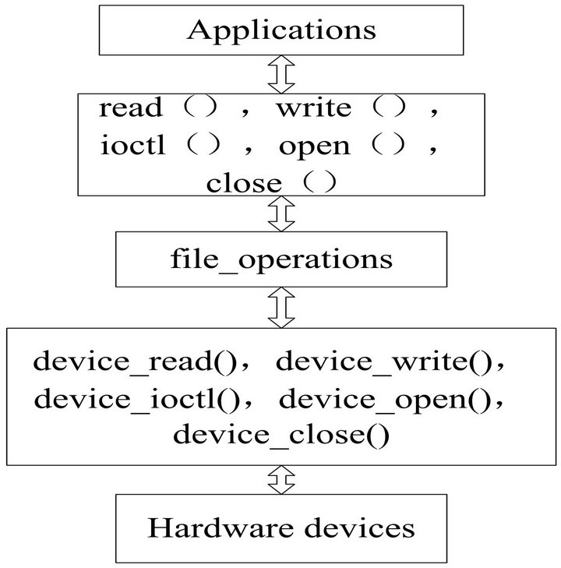
c) Implementation of camera device driver

Slide 11
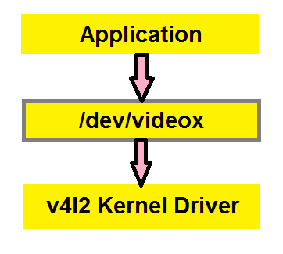
d) Video For Linux 2(V4L2)

Slide 12
d) Video For Linux 2(V4L2)
Definition
V4L2 is a collection of device drivers and API supporting realtime video capture on Linux system.

Slide 13
d) Video For Linux 2(V4L2)
a) Responsibility of V4L2
V4L2 is designed to support a wide variety of device and there are some ability of V4L2:
The video capture interface grabs video data from a camera device.
The video output interface allows applications to drive peripherals which can provide video images.
The radio interface provides access to audio streams from AM and FM tuner devices.

Slide 14
d) Video For Linux 2(V4L2)
Video capture interface
Video capture interface device sample an analog video signal and stored the digitized image in memory. After that, applications can control and move the image from driver to user space.
Camera device is an device file in Linux( /dev/video) and can be accessed like character device. Video capture device have major number is 81 and the minor number range from 0 to 63.

Slide 15
d) Video For Linux 2(V4L2)
Step of interface with capture image device
Querying capabilities: Devices supporting the video capture interface set the V4L2_CAP_VIDEO_CAPTURE flag in the capabilities field of struct v4l2_capability by VIDIOC_QUERYCAP ioctl.
Image Format Negotiation: The former select an area of the video picture to capture, the latter how images are stored in memory, i. e. in RGB or YUV format, the number of bits per pixel or width and height via APIs of V4L2.
Reading images: A video capture device may support the read() function and/or streaming (memory mapping or user pointer) I/O.

Slide 16

e) Programming V4L2 device driver
V4L2 drivers are implemented as kernel modules, loaded manually by the system administrator or automatically when a device is first discovered. The driver modules plug into the “videodev” kernel module.
Opening the device
Changing device properties( select the video or audio input, video standard, picture brightness,..).
Negotiating a data format.
Negotiating the input/output method.
Closing the device.

Slide 17
F) Get video frame
As the driver is correctly configured, the hardware captures and streams data from the device.
The Video4Linux2 API defines some different ways of transferring video frames, two of which are actually available in the current implementation.

Slide 18

F) Get video frame
Transferring video frames methods:
The read() and write() system calls can be used in the normal way. Depending on the hardware and how the driver is implemented, this technique might be relatively slow - but it does not have to be that way.
Frames can be streamed directly to and from buffers accessible to the application.

Slide 19

F) Get video frames
a) Get data by read/write functions
A naive implementation of read() on a frame grabber device is straightforward: the driver tells the hardware to start capturing frames, delivers one to the user-space buffer, stops the hardware, and returns.

Slide 20

F) Get video frames
b) Streaming I/O
With the read() and write() methods, each video frame is copied between user and kernel space as part of the I/O operation. When streaming I/O is being used, instead, this copying does not happen instead, the application and the driver exchange pointers to buffers.
These buffers will be mapped into the application’s address space, making it possible to perform zero-copy frame I/O.

Slide 21

F) Get video frames
b) Streaming I/O
There are two different types of streaming I/O buffers:
Memory-mapped buffers (type V4L2_MEMORY_MMAP) are allocated in kernel space, the application maps them into its address space with the mmap() system call.
User-space buffers (V4L2_MEMORY_USERPTR) are allocated by the application in user space.

Slide 22
3) Result
The camera driver and application in user space is completed. User can use application to get raw data from camera device.
But the qualification of image which catured by driver does not good enough.

Slide 23
4) Lesson learn
Technical skill
Learn more knowledge about Embedded Linux and how to implement driver with a device.
Learn how to develop an application and install it in mangOH development board.
Knowledge in develop device driver in Linux operating system.

Slide 24
5) Lesson learn
b) Soft skill
Have ability to work in the industry environment, interact with more technology.
Learn how to present a technical term with mentor and co-workers.
Learn communication skill, become more confidence when work with companions.
Improve ability to speak English( Toastmaster meeting).

Slide 25


